Slide 1
Natural Gas: Interruptible Delivery Service
Matt Taylor, Issuing Officer
Daniel Garnett Contract Manager
Nov. 15, 2021

Slide 2
This Webinar is Eligible for CEUs
To obtain credit for attending this live event, you will need to self-report your attendance by logging into your student account in the Learning Management System https://doas.exceedlms.com/
Instructions for self-reporting CEUs is available through the SPD Training Reference Guide. Please reference pg. 4 “External Courses Credits” for step-by step instructions.
1 CEU is granted for every 50 – 60 minutes of content
Please share any questions with us at georgia.learning@doas.ga.gov

Slide 3
Purpose of this Webinar for Natural Gas – Interruptible Delivery Service:
Familiarize You with the New Contract and Your SPD Team
Review Contract Details and Features
Overview of the Awarded Suppliers
Explain Where to find the Contract in TGM
Explain How to Order product/service from this Statewide Contract
Tell You where to go for more Information
Today we will:
State of Georgia

Slide 4
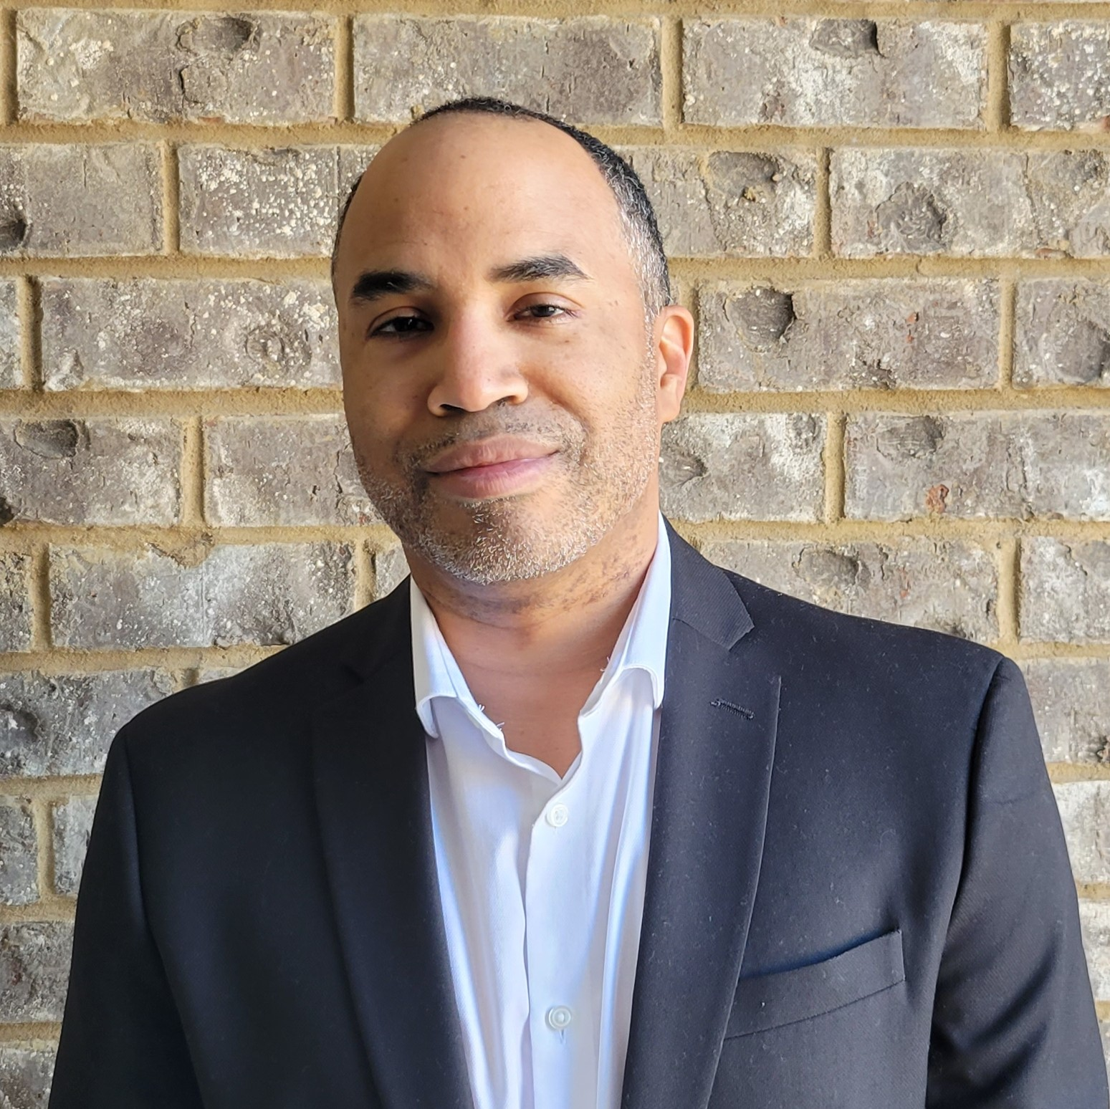
YOUR SPD TEAM
Title: Issuing Officer
Matt Taylor
Contact Information: Matt.Taylor@doas.ga.gov
404-657-7728
Title: Contract Manager
Daniel Garnett
Contact Information: daniel.garnett@doas.ga.gov
404-651-6084

Slide 5
This Statewide Contract for Natural Gas – Interruptible Delivery Service is designed to:
Provide natural gas through interruptible delivery service to:
State Agencies
Universities/Colleges
Correctional Institutions
Local Government & Municipalities
State of Georgia
Notes:
This contract can be best described as a “Mandatory” contract. Your DOAS procurement team has worked extremely hard to conduct a solid competitive solicitation for this category which has resulted in very deep discounts on the Hosted Catalog for Paints and Accessories. If you consider the full market-basket of products offered, you will see the awesome leverage of State spend which served as the solid foundation for favorable pricing – pricing which would be very difficult to compete with independent of this contract.

Slide 6
Natural Gas: Interruptible Delivery Service
Contract Benefits
Convenient
Natural Gas Program Manager is available to assist
customers in obtaining their natural gas along with
explaining options and services provided.
Dedicated contract management team who will
manage the daily operations of this statewide
contract.
Authorized user may choose among the awarded
suppliers.
Notes:
This contract can be best described as a “Mandatory” contract. Your DOAS procurement team has worked extremely hard to conduct a solid competitive solicitation for this category which has resulted in very deep discounts on the Hosted Catalog for Paints and Accessories. If you consider the full market-basket of products offered, you will see the awesome leverage of State spend which served as the solid foundation for favorable pricing – pricing which would be very difficult to compete with independent of this contract.

Slide 7
Statewide Contract Overview
Contract Description:
“Mandatory” Statewide Contract
This awarded contract replaces statewide contract 99999-001-SPD0000099.
Fixed Rates for gas and delivery
Contract Number: 99999-001-SPD0000192 (0001 – 0002)
Summary of Products Available Under Statewide Contract:
This contract provides for the interruptible delivery of natural gas.
Authorized user may choose among the awarded suppliers for service under the statewide contract.
Base Term: 2 Year Initial Term which began on Nov. 1, 2021.
Number of Contract Renewals: Five (5) One (1) Year Renewal Options

Slide 8
PRODUCTS, SUPPLIERS, & SCOPE
Program Manager
The State has a contract with W. Brent Phelts, PE. Mr. Phelts is the Georgia Natural Gas Program Administrator to develop and manage deregulated natural gas services for all program participants.
New Accounts
To initiate service and inquire about the natural gas services, the Program Manager requests each new or prospective participant call or e-mail with your base entity information to initiate service. A sign-up form will be provided by Mr. Phelts.
Required information must include name of entity and facility location(s), list of accounts and Atlanta Gas Light Company account numbers, and billing address (as shown on invoice/bill or preferred bill address).
To initiate service for your facility(s), please contact Brent Phelts, Phone: (404) 271-7077 or Email: wphelts@mindspring.com.

Slide 9
Awarded Suppliers
Statewide Contract Suppliers
Gas South, LLC (99999-001-SPD0000192-0001)
Texican Industrial Energy Marketing (99999-001-SPD0000192-0002)

Slide 10
Supplier Contact Information
Gas South, LLC
Rob Kealler, Senior Commercial Account Executive
Phone: 770-763-4674
Email: Robert.Kealler@GasSouth.com
Texican Industrial Energy Marketing
Lindsey Cline Starley, Sr. Business Development Representative
Phone: 404-579-8553
Email: lstarley@texican.com

Slide 11
TEXICAN INDUSTRIAL ENERGY MARKETING
Lindsey Starley Paul Hyland
Cell (404)579-8553 Cell (404)550-0628
lstarley@texican.com phyland@texican.com

Slide 12
Texican has been in business since 1985
Offices in Houston, Atlanta & Charlotte
Texican serves over 400 commercial, industrial, municipal, governmental, institutional, and EMC customers
Texican sells 250,000 MMBtu – 300,000 MMBtu per day on average company wide
Largest independent shipper, & one of the largest overall on Southern Natural Pipeline and AGL
Independent Marketer & Full Service Marketing Company
Minority Certification - Texican is a first tier nationally certified Minority Business Enterprise, now bringing the added benefit of minority spend to customer supply chains.

Slide 13
How to Find the Contract on Team Georgia Marketplace

Slide 14
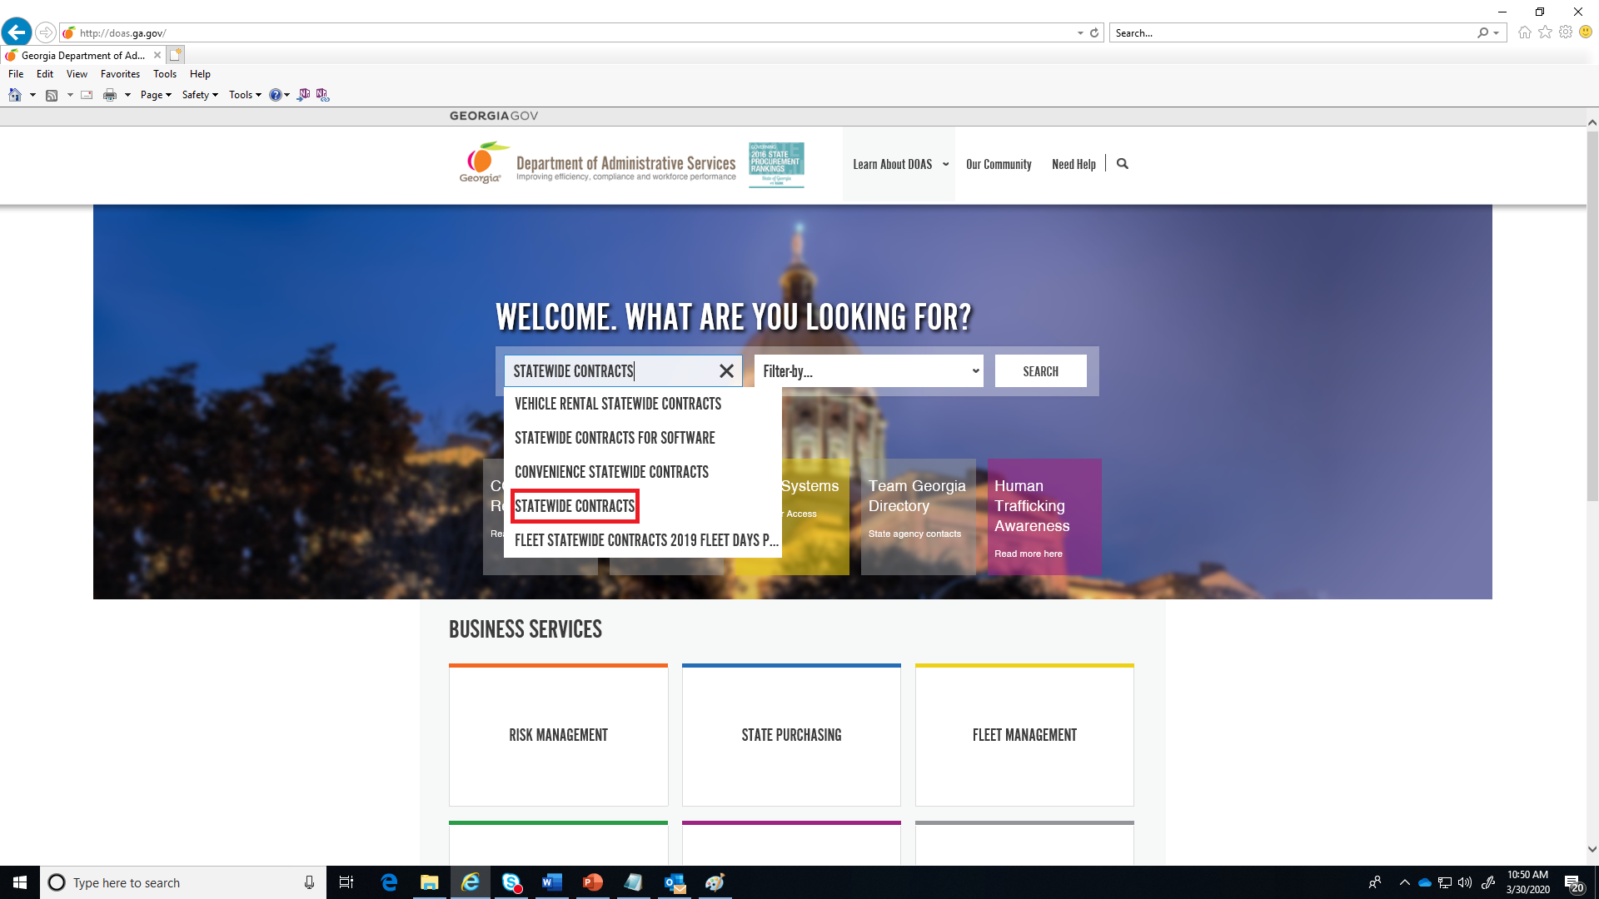
Navigating Team Georgia Marketplace (TGM)
www.doas.ga.gov

Slide 15
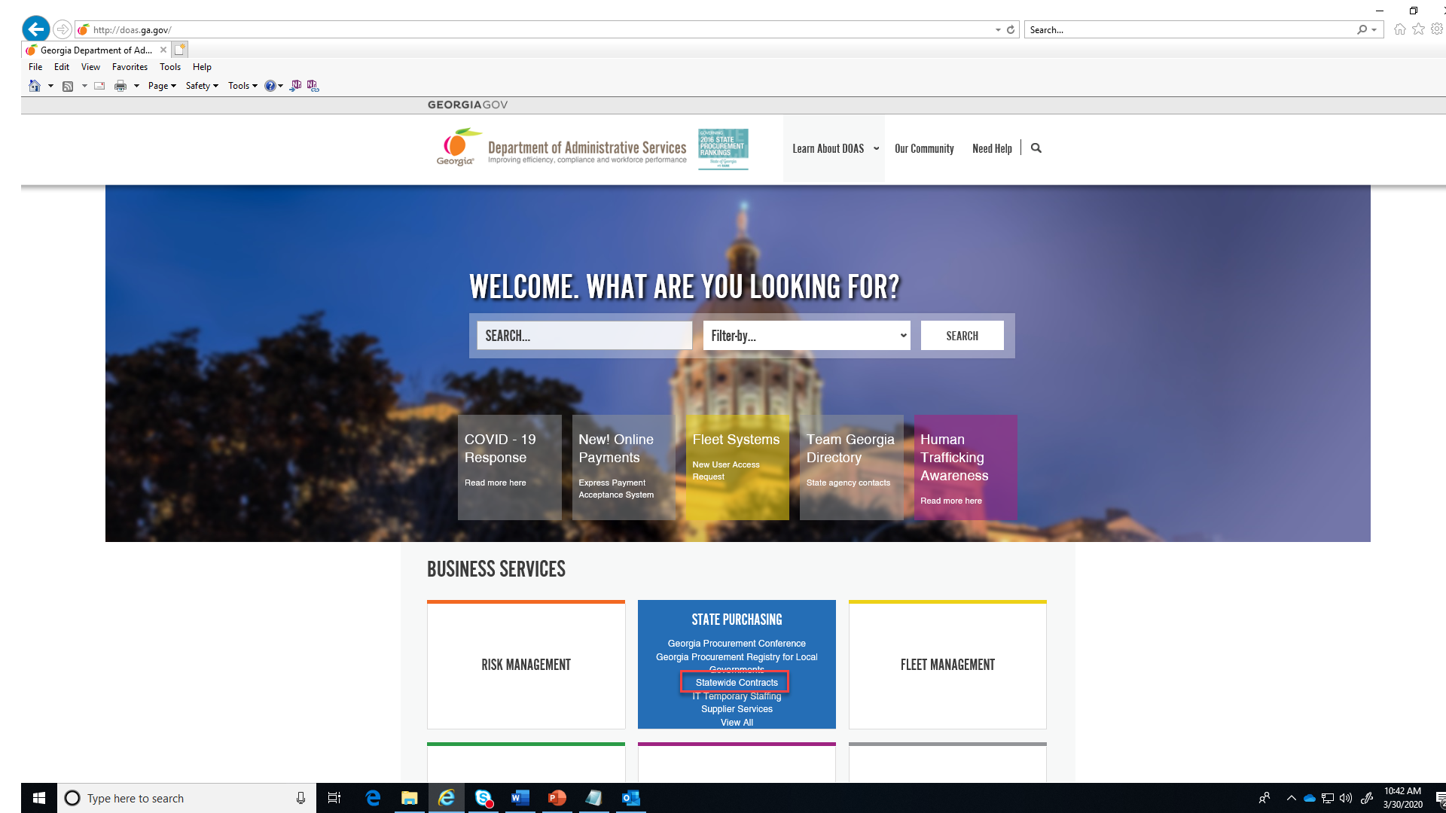
Navigating Team Georgia Marketplace (TGM)
www.doas.ga.gov

Slide 16
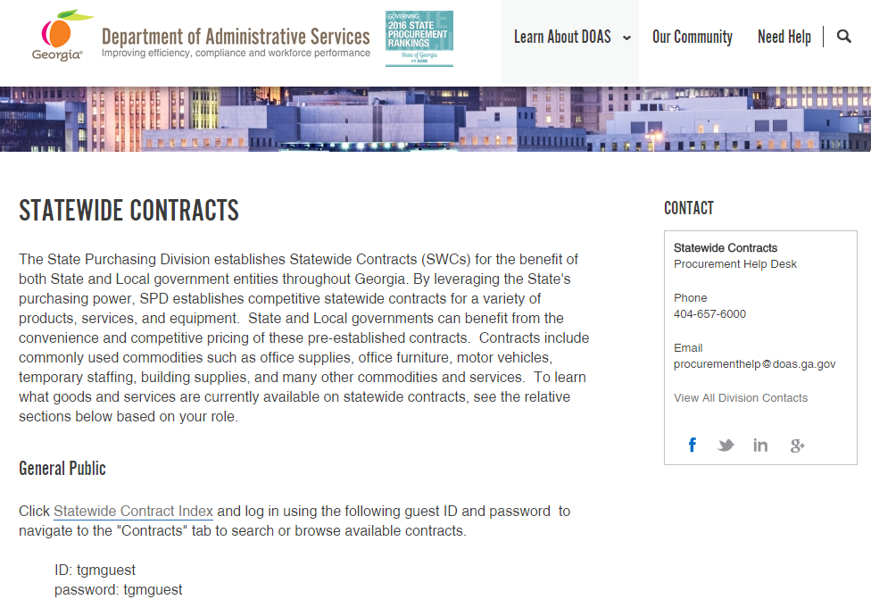
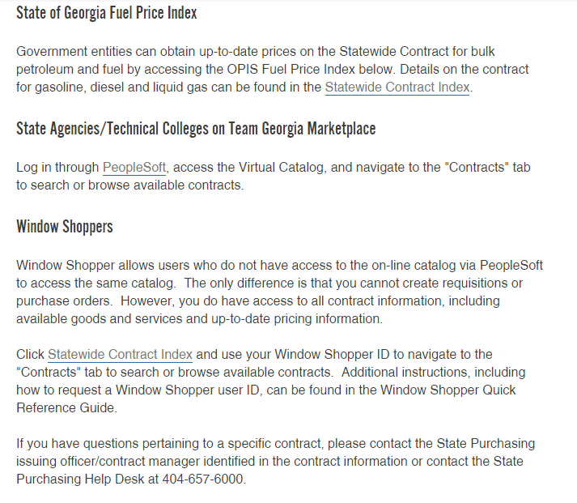
Where to Find this Statewide Contract State Purchasing Division – Statewide Contracts
You can access the Statewide Contract Index by clicking on these links

Slide 17
Navigating Team Georgia Marketplace (TGM)
ID: tgmguest
Password: tgmguest
Notice Login Info
Click on “Statewide Contract Index”

Slide 18
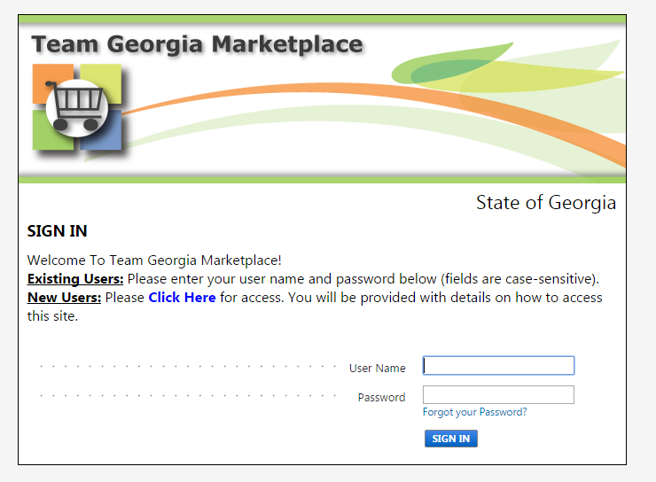
Statewide Contracts Index
Window Shoppers
Two Options:
Personal User Name & Password
Or
Generic Login
User name: tgmguest
Password:
tgmguest
If you are a Window Shopper user, you can access the Statewide Contract Index by entering your personal User Name and the Password once the Login screen displays. Then, click on the Contracts tab.

Slide 19
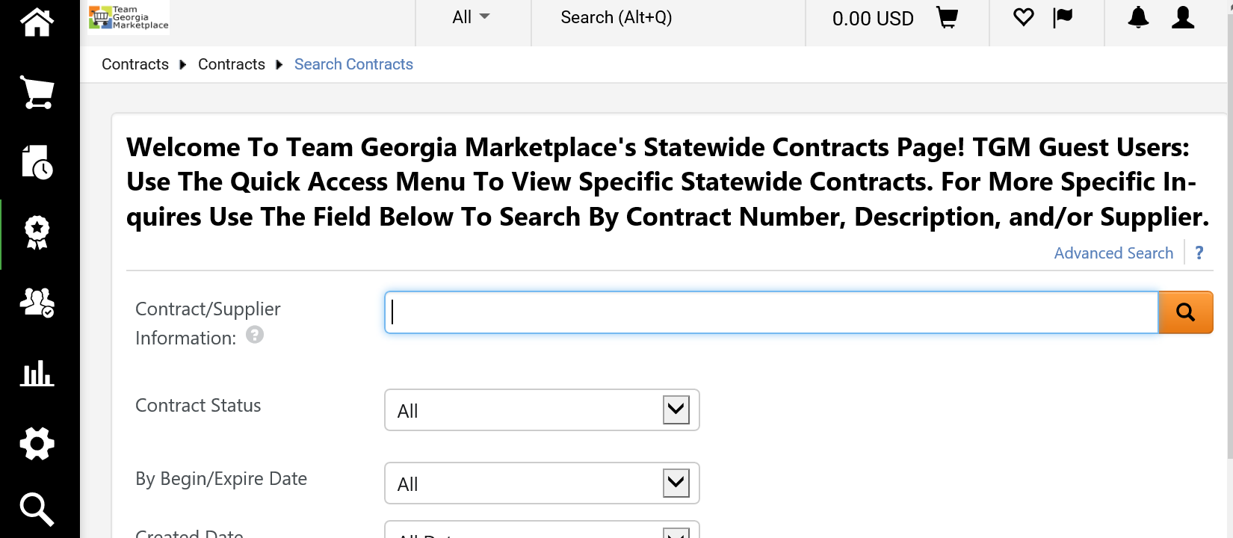
Team Georgia Marketplace Contracts
Once you access the system you can do a search to access for Statewide Contracts.
Enter:
“gas”
“interruptible”
“natural gas”
“pool group”

Slide 20
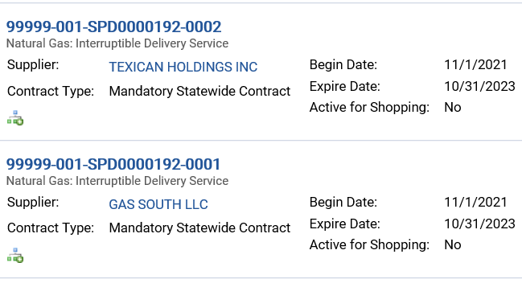
Team Georgia Marketplace Contracts
Click on
Desired
Contract

Slide 21
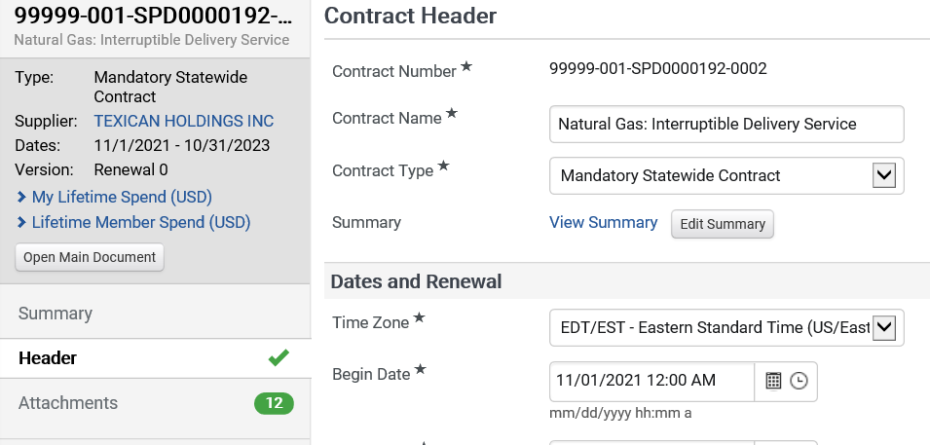
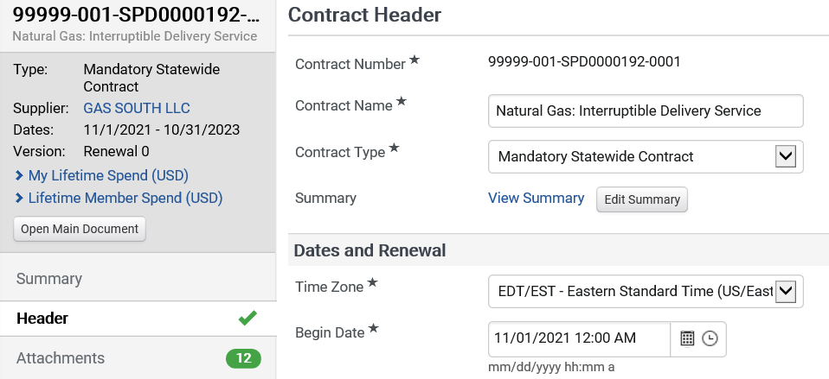
Team Georgia Marketplace Contracts
Click on Attachments

Slide 22
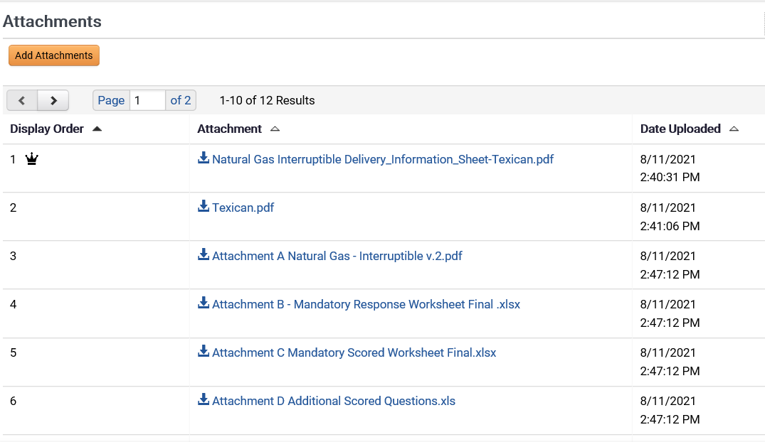
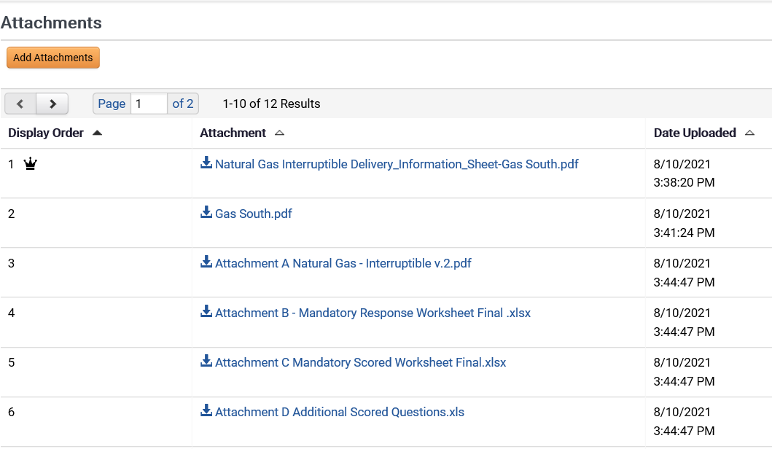
Team Georgia Marketplace Contracts
Review Contract Documents

Slide 23
GETTING STARTED……..EASY!!!!
Step 1: Review Contract Documents in Team Georgia Market Place for Contracts 99999-001-SPD0000192-0001 Thru 0002
Step 2: Contact the Supplier of Choice who will provide Quotes and Purchase Information
Step 3: Cut Purchase Order
Notes:
[Title of the course]
9-Nov-21
Copyright © 2004-2005 NameOfTheOrganization. All rights reserved.
23
Existing Contracts Remember statewide contract (#90794) will no longer be good after October 1, 2017. Again, this statewide contract is resulting from a very competitive bidding environment, DOAS awarded statewide contracts to Sherwin Williams 99999-SPD0000144-001 for Paint and Accessory items.
The projected “Go-Live” date for this new contract is 10/01/2017.

Slide 24
Questions:

Slide 25
More Information?
Daniel Garnett, Contract Manager
daniel.garnett@doas.ga.gov 404-651-6084
DOAS Help Desk:
ProcurementHelp@doas.ga.gov 404 -657-6000

